Slide 1
Big data and statistics
Fabien Cellier

Slide 2

Introduction
Don’t try to do all by yourself:
Math, code, data integration…
… too many fields to cover
=> Don’t be greedy:
SHARE your work

Slide 3
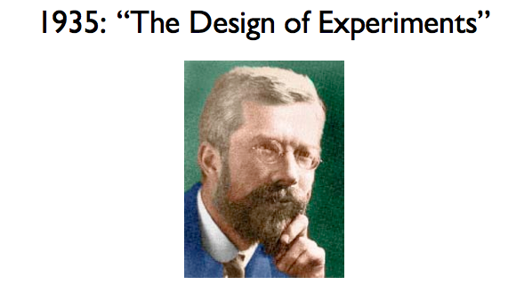
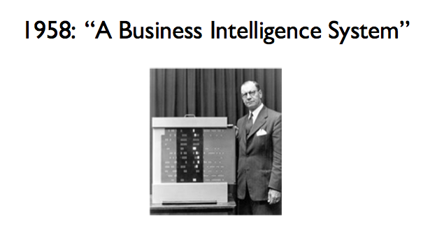
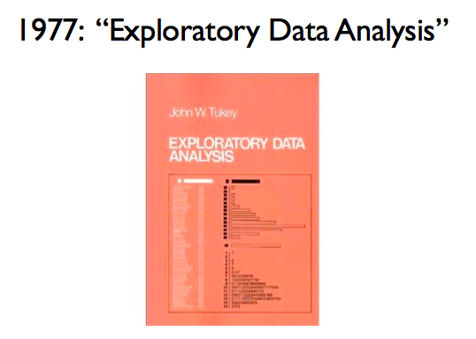
Introduction
R.A Fisher
Peter Luhn

Slide 4
Introduction
Probability to find winner in sport
Find good employee
Sentiment analysis, your firm’s reputation
Find the next death in game of thrones, and next interactions between characters
...

Slide 5
Introduction
For the audience, please :
Number of people (number of women and men)
Heigth
Own a car
Is in student office
Happy hour during the last 10 days?
Glasses
=> combinatorial explosion

Slide 6
Plan
Univariate statistics (description )
Modality, mean, quantile, standard deviation
Distributions
Theory of large number, big data and random
Principle of machine learning
Causality, Correlation, Confounding
Multivariate statistics
Covariance,SVD,PCA
Independance
Statistical significance
How to clean data and warning about it

Slide 7
Plan
Change View of the data
Distance,word, pixel, convolution, fourier …
Timeseries: stable entry or streaming ?
Exercise : Bayesian and Simple spam detector ?
Theoretical case : Simple recommendation algorithm from e-commerce 2-4 people in each team)
Exercise : Student's office members predictor or athletic people or/and good result (with collect)
Quick introduction to neural network (spoiler for the next course)

Slide 8
Univariate statistics

Slide 9
Univariate statistics
Modelisation of entry (or observation ) as vector:
χ_{j} = x_{1j},x_{2j}…, x_{nj} All entries create a matrix
Entry could be
Categorical : x_{ij} is integer or boolean
Numerical : x_{ij} is real
Generally, statistics with a fix j on all possible values of j (column)

Slide 10
Univariate statistics
Statistics on column to estimate quantity of information on a feature
Statistics on line ( sparsity, later multivariate statistics)

Slide 11
What kind of numbers?

Slide 12


Univariate statistics
Minimum, Maximum
Mean ( or modality )
Median
Standard deviation (dispersion)
Quantile

Slide 13
Univariate statistics
Example for dispersion/information density with standard deviation:
Take a picture:
For X in P: if standard deviation of (neighbors(X) + X) <= threshold
⇒ same region

Slide 14
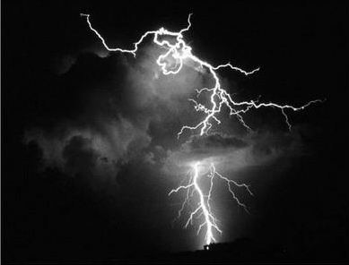
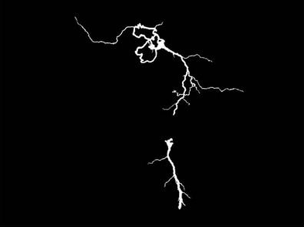
Univariate statistics
Example for dispersion/information density with standard deviation:

Slide 15
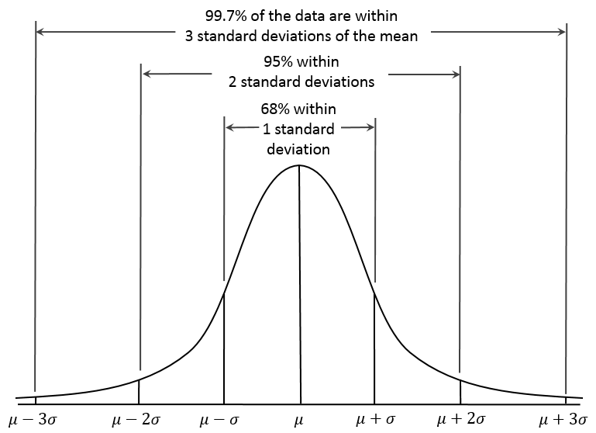
Univariate statistics : distribution
Fair coin (Gaussian/Normal Distribution)
X number of time we have a “face” result
Y probability
μ Mean
σ Standard deviation

Slide 16
Univariate statistics : conclusion
Description of your data
Try to find the right distribution for your case
Check with expected values (fair coin => normal distribution)
Check bias, incoherence
Correct your data and/or explain the delta
Keep in mind rare event difficulties
Try to balanced data if possible
First possible prediction is now possible
This is classical Business intelligence (BI)

Slide 17
Theory of large number, big data and random

Slide 18
Theory of large number, big data and random
Big data is a term for data sets that are so large or complex that traditional data processing applications are inadequate.
( wikipedia )
50 Go of video with deeplearning : big data because can’t handle on a single server
1 To of text for sentiment analysis not big data

Slide 19
Theory of large number, big data and random
Many samples : low probability to have an extreme case
10 launch of fair coin on with “face” result : 1/ 1 024
20 launch of fair coin on with “face” result : 1/ 1 048 576
Possibility to use sample of sample ( beware of confidence value)
Find distributions
Gibbs sampling (Monte Carlo Markov chain)
Filtering of data, subcategories, avoid outliers….

Slide 20

Theory of large number, big data and random
Monte Carlo :
Drawing a large number of pseudo-random uniform variables from the interval allows to approximate the “form”

Slide 21

Theory of large number, big data and random
Exercise:
10⁹ result for a 20 sided die. How to be sure my die is fair if i can retrieve only 10 results at a time and store only 1 number?
( 3 methods minimum! )

Slide 22
Result
The sum is probably in the 3σ interval
Samples should follow a standard distribution
(suppose exact number and creation of a bijection :-)

Slide 23
Principle of machine learning

Slide 24
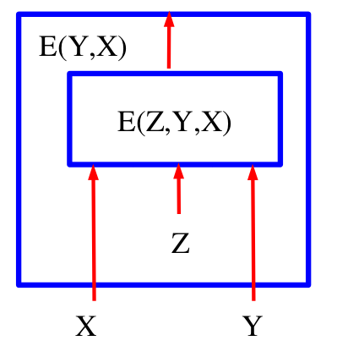

Principle of machine learning
Two visions:
Use experience and bias to learn and generalise the model
Ex: prediction from repartition
I know you love video games, marvel, and you work as computer engineer, can I predict your sex with good accuracy?
Energy based models: cure against bayesians fundamentalism (lecun 2007)

Slide 25
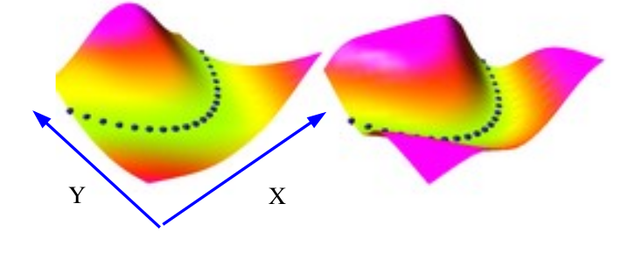
Principle of machine learning
Which result R as the maximum probability to be the result for a given input χ
Minimisation of E(X,Y)

Slide 26
Causality, Correlation, Confounding

Slide 27
Causality, Correlation, Confounding
Causality : Cause => effect (separation and consequence)
Correlation : Not dependant, eg. the occurrence of one does not affect the probability of the other. ( one coin and one die are launched together, the result of the first do not influence the result of the second)

Slide 28
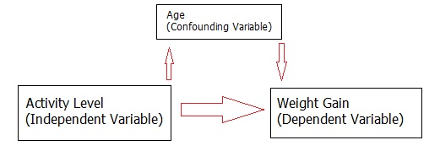
Causality, Correlation, Confounding
Confounding: Careful with interpretation of results
=> A variable which influence the cause AND the consequence
Example*:
*Source : http://www.statisticshowto.com/confounding-variable/

Slide 29
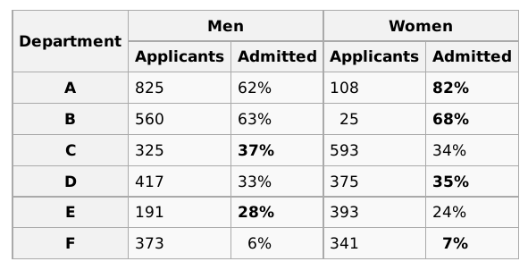
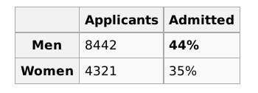
Causality, Correlation, Confounding
Going further: Simpson’s paradox ( Admission in berkeley )

Slide 30
Causality, Correlation, Confounding
Going further: Simpson’s paradox ( berkeley student )
Men have best result but
Women seems to apply generally on difficult department
Women have better result when apply on competitive department

Slide 31
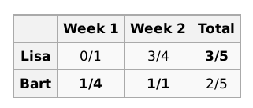
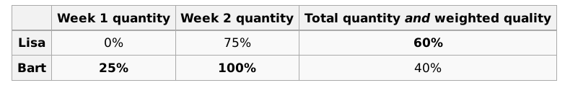
Causality, Correlation, Confounding
Going further: Simpson paradoxe ( Improve wikipedia )

Slide 32
Causality, Correlation, Confounding
Conclusion: Be extremely careful with conclusion AND always check your hypotheses

Slide 33
Multivariate statistics

Slide 34

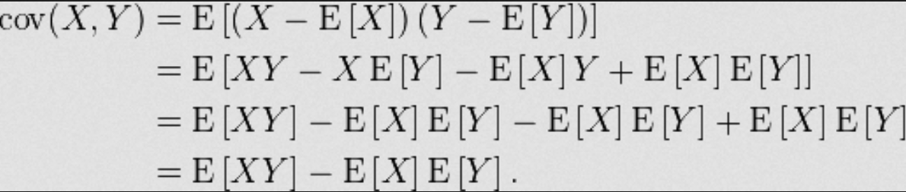
Multivariate statistics
Covariance: measure of how much two random variables change together
Covariance matrix: Square matrix where a_{ij} represent the covariance between X_{i} and X_{j}

Slide 35

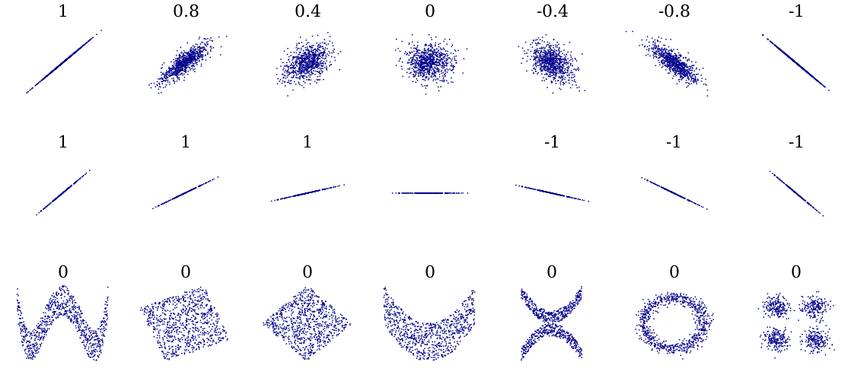
Multivariate statistics
Correlation :

Slide 36
Multivariate statistics
Singular value decomposition) :
Generalization of the eigendecomposition
Use as pseudo inverse for some computation (least square error)
Not simple solution (one algorithm http://www.netlib.org/lapack/lawnspdf/lawn03.pdf or use matlab)
Avoid to use the solution “A^{H}A” solution because the square is a problem for the accuracy

Slide 37
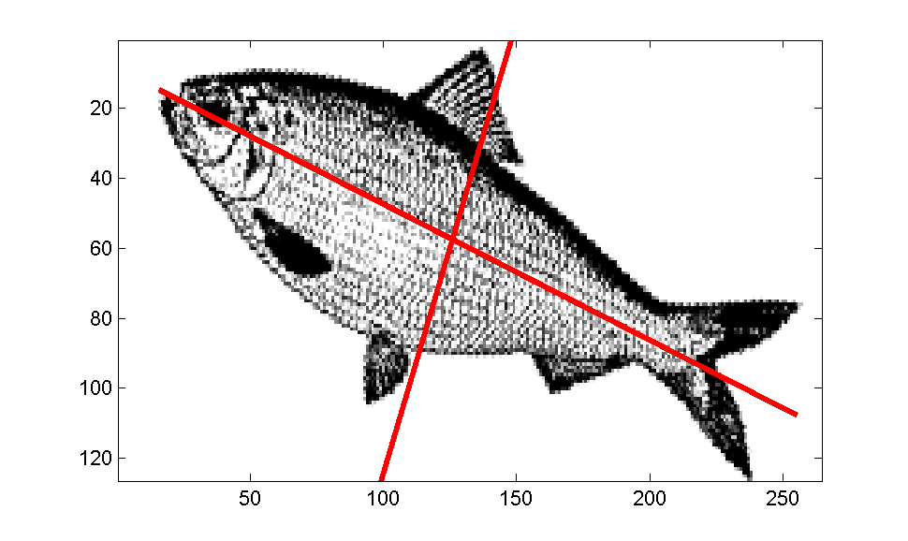
Multivariate statistics
PCA:
Find axes of the dispersion of the data
Algorithm:
Mean vector (in dimension of the data N)
Compute the covariance matrix
Compute eigenvalues and eigenvectors
Sort the eigenvectors by decreasing eigenvalues (choose k<N if you want decrease dimension)
Use eigenvector matrix to transform the samples onto the new subspace.

Slide 38
Multivariate statistics
Independance:
Compare the value with statistical value we should observe if there were no dependance:
2 Groups : 1 - > 17 people , 2 -> 19 // 12 women, 24 men
Group 1 (theorie) : 5.7 women, 11.3 men
Observation : 3 women, 14 men
Bias : women -2.7 … Is it significant ?

Slide 39
Multivariate statistics
Test χ² (Chi 2 ) :
Hypothese H0 : Gender has no influence
Coef Chi2 = (obs - theorie)²/theorie²
We reproduce the test for all possibility (group 1 and men, group 2 and women etc…)
We sum all coefficient and we obtain Chi2 = 3.567

Slide 40
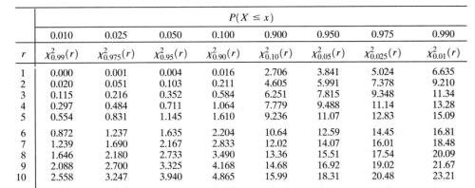
Multivariate statistics
Test χ² (Chi 2 ): (computed 3.5)
We find the degree of liberty and error margin :
Z = (number of line -1) * (number of column -1)

Slide 41
Multivariate statistics
Test χ² (Chi 2 ):
Need a sufficient number of sample
Some alternative (fisher’s test or χ² from yates etc…)
Think simple: if I set one variable, does the distribution change?
(fair die and a coin, if I pick only the result with 1 on the die, would I have more “face” result ?)

Slide 42
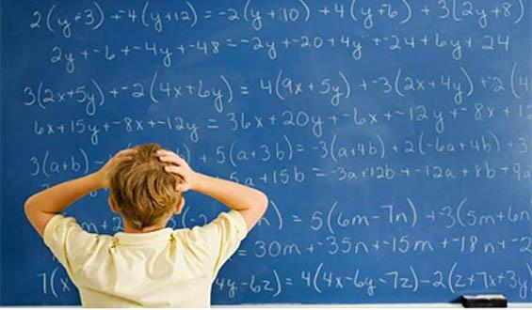
Multivariate statistics
For some people:

Slide 43

Multivariate statistics
Independance : use random !
Ironic

Slide 44
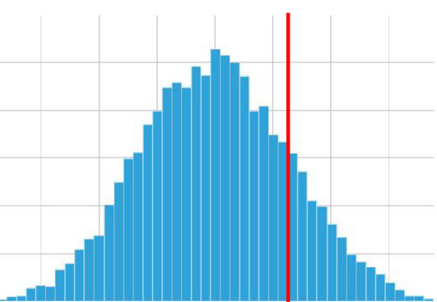
Multivariate statistics
Independance : use random !
Simulate the distribution with your characteristics:

Slide 45

Multivariate statistics
Statistical significance
Is a 5 difference between mean ( 72 and 67 ) is statically significant?
(Replace with the number you want)
=> First solution for the laziest (like me) : Shuffle the value, see the new difference between mean, repeat
how many times the difference is greater than 5 ? (is it often?)

Slide 46
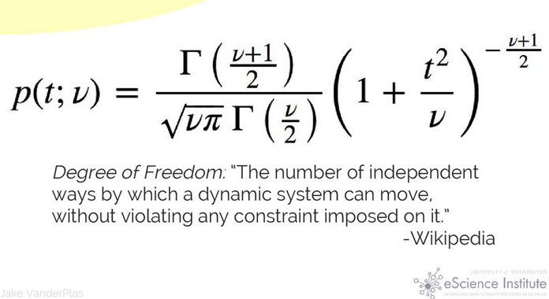
Multivariate statistics
Statistical significance (student)

Slide 47
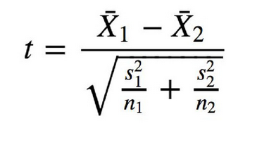
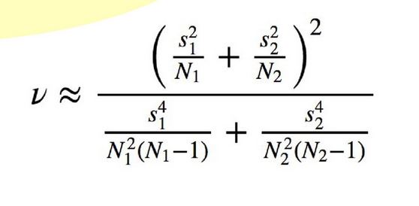

Multivariate statistics
(welsch)
Gamma :

Slide 48
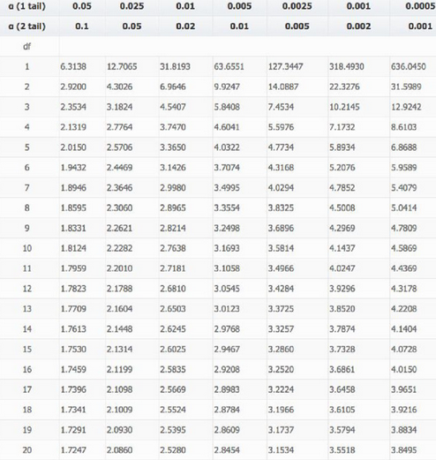
Multivariate statistics

Slide 49
Too much beauty, take a break

Slide 50
Multivariate statistics
Use “Admission in berkeley” to play!!!!

Slide 51
How to clean data and warning about it
Problems :
Bad measure/captor
Fraud
Other Anomalies
Rare events
No data
Bad samples
….

Slide 52

How to clean data and warning about it
If you can : delete !!!
Why ? because generate or correct data could
Could change your behavior
Erase information
Deviate your data
...

Slide 53
How to clean data and warning about it
If you must try (for example if you can use only numerical data):
To use multiple solution ( add average, random )
Validate your conclusion with AND without your new/filled data
For machine learning:
Depends on the algorithm but try to add extreme value to discriminate
Stack algorithm
In big data if you have not enough value...

Slide 54
Change View of the data
We have already seen :
PCA
SVD
Help to understand the topology of the data : easier to create a model

Slide 55
Change View of the data
Change the distance ( L2 or other like minkowski or russelrao ...)
Change the domain (fourier, mfcc, time-frequency for sound and speech recognition)
Consolidate information (add delta and double delta,eg. Speed and acceleration)
Create a window to have a fix input
Use tools to compare/segment your data (Dynamic Time warping, k-means)

Slide 56
Change View of the data
Generally, where to use window or memory with timeseries
Window:
Many input with short history
Fixed delay between entries
Could create a summary easely (last day/month/year…)
If you need quick-win
Memory:
Long series for one input (captors)
No fixed delay between entries
Can use very elaborate model (LSTM)
If you have time to optimize
No absolute rules => LSTM can be used with images !!!

Slide 57
Question before fun with exercise?

